Slide 1
Introduction to Python
Class 3

Slide 2
Resources
eBook
Hard Copy book
Visualizing Code tool
Cheat Sheets
*Control click to go to the link.

Slide 3
Review: Comparison Operators
Operator | Name | Syntax
> | Greater Than | age > 40
< | Less Than | age< 40
>= | Greater or Equal to | age>= 40
<= | Less than or Equal to | age < =40
== | Equality | age == 40
!= | Not equal to | Age != 40

Slide 4
Review: String Methods
Operator | Purpose | Input | Syntax | Output
upper() | Converts to Upper Case | name = “Monty” | name.upper() | MONTY
lower() | Converts to lower case | name = “Monty” | name.lower() | monty
title() | Converts to Title case | name = “monty” | name.title() | Monty
len() | Counts number of characters | password = “monty” | len(password) | 5
replace() | Replaces parts of a string | s = “I like my dogs” | s.replace(“like”,”love”) | I love my dogs
Python is case sensitive. “Monty” != “MONTY”

Slide 5
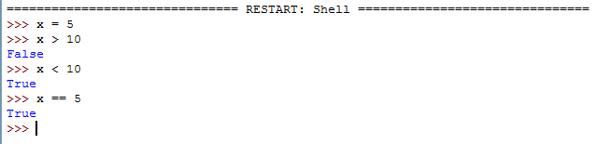
Review: Comparison Operators
Comparison operators return Boolean values abbreviated bool() in Python
Booleans are binary and return only True or False (case sensitive)
In Python, all numbers are True except 0
In Python, all strings are True except a blank string
For loops and conditional statements, Python will only run when True

Slide 6
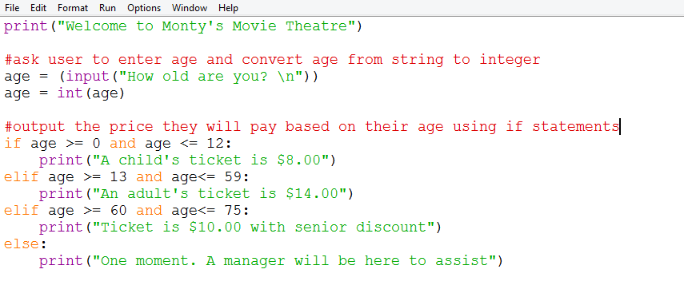
Review: Conditional Statements
Conditional statements will only execute if the comparison operators returns True
If the operator returns False, the program will execute the next elif or else statement
The syntax for a conditional statement is below:
Code
Notes:
print("Welcome to Monty's Movie Theatre")
age = (input("How old are you? \n"))
age = int(age)
if age >= 0 and age <= 12:
print("A child's ticket is $8.00")
elif age >= 13 and age<= 59:
print("An adult's ticket is $14.00")
else:
print("One moment. A manager will be here to assist")

Slide 7
Libraries
Libraries are a collection of procedures, functions, operations, elements that someone else created and you can use in your program. Some libraries are built-in while others need to be installed using command prompt (pip install)
Some popular libraries include
os - used to interact with your underlying operating system (Windows/Linux/Mac)
random – used to generate random numbers
math – provides advanced mathematical functions (such as trigonometry)
datetime – used when working with dates and times
pandas - used for data manipulation and analysis
requests – used for sending http requests and calling APIs
scrapy – used for webscrapping

Slide 8
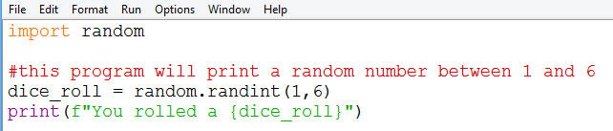
Random library
The random library is pre-built and allows you to generate random numbers

Slide 9
Random library
The random library is pre-built and allows you to generate random numbers

Slide 10
Methods vs functions
So far we have worked with functions like print(x) and len(number)
Those functions should be in purple font when typed in the default IDE
Methods are types of functions but are attached to an object (like a library or list)
Methods do not change color in the IDE like functions do
Methods take on the following format:
object
method
arguments
random.randint(1,6)

Slide 11
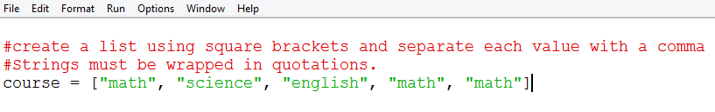
Lists
While variables can store one value at a time, lists can store many values
When naming lists, follow the same naming conventions as naming variables except it is best practice to name lists in the plural (cars, groceries, students)
Lists are mutable meaning they can be changed after they are created
Values in a list can repeat

Slide 12
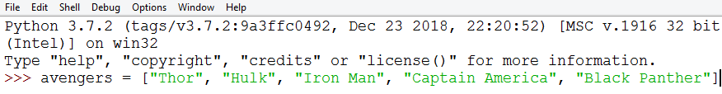
Lists are Indexed
Lists are indexed meaning each value in the list corresponds to an index integer
Lists (as well as ranges) start counting from 0
The first value in the list is index 0, the second item is index 1
Indexing can help you print parts of the list or save them as variables or other lists
Index 0 1 2 3 4

Slide 13
Retrieving Data from a list – negative indexing
Index 0 1 2 3 4
Neg index -5 -4 -3 -2 -1
Syntax | Description | Output
print(avengers[-1]) | Negative indexes will start from the counting from the right or the list | Black Panther
print(avengers[-3:-1]) | Print indexes -4 and – 3 | ['Iron Man', 'Captain America']
print(avengers[-3:]) | Prints everything to the right of -3 index | ['Iron Man', 'Captain America', 'Black Panther']

Slide 14
Retrieving Data from a list
Syntax | Description | Output
“Spiderman” in avengers | Checks if a value is in a list | False
“Spiderman” not in avengers | Checks if value is not in a list | True
print(len(avengers)) | Prints count of values in Avengers | 5
print(avengers[20]) | Attempts to prints the 20th index which does not exist | IndexError
print(avengers.index(“Thor”)) | Returns the index of Thor | 0

Slide 15
Adding Data to a list
Syntax | Description
avengers.append(“Dr. Strange”) | Adds value to the end of the list
avengers.extend(justiceleague) avengers.extend([1,2,3,4]) | Adds multiple values to end of list combining lists
avengers.insert(2, “Dr. Strange”) | Inserts value or a list into index 2

Slide 16
Sorting Data in a list
0 1 2 3 4
Syntax | Description
avengers.reverse() | Reverses the order of list
avengers.sort() | Sorts list alphabetically then numerically
avengers.index(“Thor”) | Will tell you which index Thor is in

Slide 17
Removing Data in a list
0 1 2 3 4
Syntax | Description
avengers.clear() | Removes everything inside the list
avengers.pop(1) | Removes index 1 from list . If no arguments are passed it will remove the last index. The value is returned case you want to use it for something else (such as store it in a variable)
avengers.remove(“Thor”) | Removes first instance of Thor it finds. Will return a value error if you try deleting something that does not exist

Slide 18
Other list Methods
0 1 2 3 4
Syntax | Description
avengers.count(‘Hulk”) | Counts number of times “Hulk” appears in list
x = avengers.copy() | Makes a copy of the original list
avengers[0], avengers[1] = avengers[1], avengers[0] | Swaps values in the list

Slide 19
Loops
A loop is a way of having your code repeat
Just like conditional statements (aka if statements), a loop will continue executing when the condition evaluates to True
A loop that never becomes False is known as an infinite loop
There are 2 types of loops: while loops and for loops

Slide 20
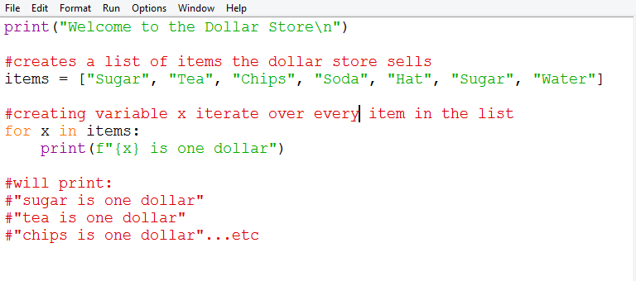
For Loops
Notes:
print("Welcome to the Dollar Store\n")
#creates a list of items the dollar store sells
items = ["Sugar", "Tea", "Chips", "Soda", "Hat", "Sugar", "Water"]
#prints the price of every item in the list
for x in items:
print(f"{x} is one dollar")

Slide 21
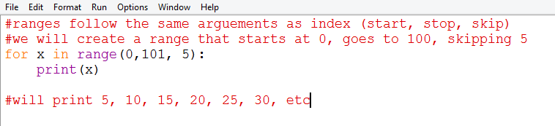
Loops to Iterate over Ranges
Rather than iterating over lists, you can iterate over a range to control exactly how many times the loop runs
Ranges follow the same rules as indexing (inclusive start, exclusive stop, skip)

Slide 22
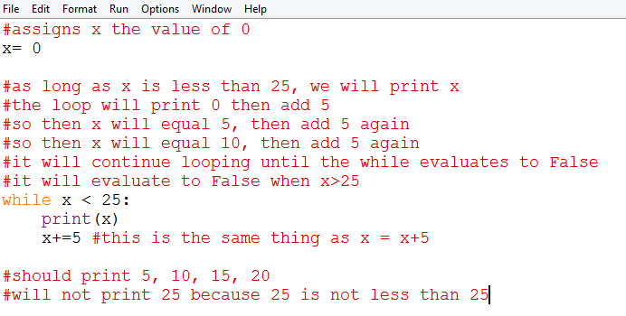
While Loops
While loops follow similar syntax to for loops and if statements (colon after the statement and indentation)
It allows you to loop through certain code as long as the conditions return True

Slide 23
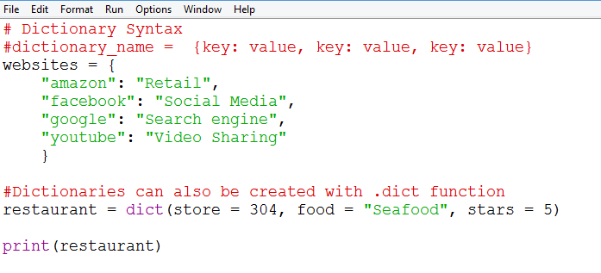
Creating a dictionary
Notes:
# Dictionary Syntax
#dictionary_name = {key: value, key: value, key: value}
websites = {
"amazon": "Retail",
"facebook": "Social Media",
"google": "Search engine",
"youtube": "Video Sharing"
}
#Dictionaries can also be created with .dict function
restaurant = dict(store = 304, food = "Seafood", stars = 5)
print(restaurant)

Slide 24
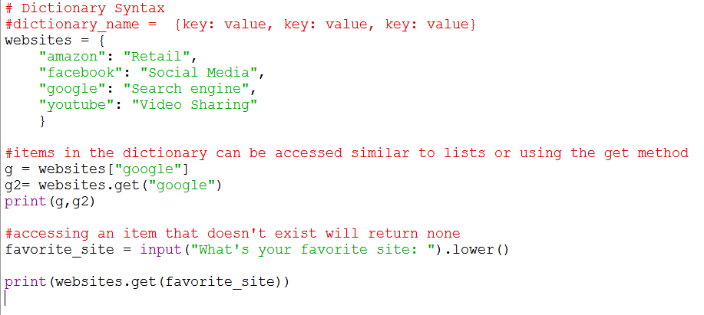
Accessing data in a dictionary
Notes:
# Dictionary Syntax
#dictionary_name = {key: value, key: value, key: value}
websites = {
"amazon": "Retail",
"facebook": "Social Media",
"google": "Search engine",
"youtube": "Video Sharing"
}
#items in the dictionary can be accessed similar to lists or using the get method
g = websites["google"]
g2= websites.get("google")
print(g,g2)
#accessing an item that doesn't exist will return none
favorite_site = input("What's your favorite site: ").lower()
print(websites.get(favorite_site))

Slide 25
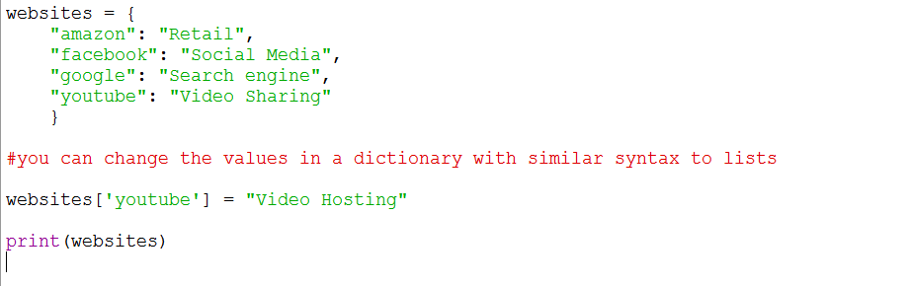
Updating data in a dictionary

Slide 26
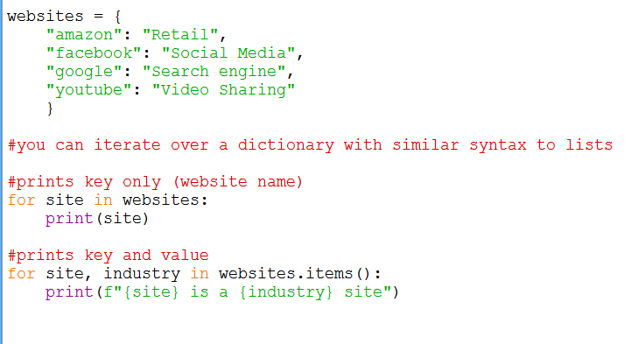
Iterating over a dictionary
Notes:
#Syntax: open and close dictionary with curly bracket
#enter key on the left, value on the right separated by a colon
#each key value pair is separated by a comma
websites = {
"amazon": "Retail",
"facebook": "Social Media",
"google": "Search engine",
"youtube": "Video Sharing"
}
#you can iterate over a dictionary with similar syntax to lists
for x in websites:
print(x)

Slide 27
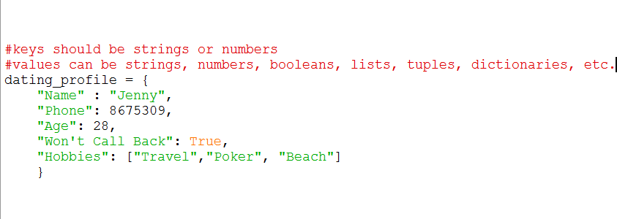
What can I put in a dictionary?
Notes:
#Syntax: open and close dictionary with curly bracket
#enter key on the left, value on the right separated by a colon
#each key value pair is separated by a comma
websites = {
"amazon": "Retail",
"facebook": "Social Media",
"google": "Search engine",
"youtube": "Video Sharing"
}
#dictionary values can be strings, numbers, booleans, lists, tuples
grades = {
"Jane" : 90,
"Emily": 83,
"Sam": 80,
"Ben":88
}

Slide 28
Review:
What is the difference between x = 5, x==5, and x+=5
What is the difference between a list and a variable
What is a conditional statement?
How do you import a library
What are the arguments ranges and indexing take?

